Slide 1
Capstone Project : Pneumonia Detection Challenge
Team Members:
Christopher Chittilappilly
Muhammed Basil MT
Niel George Varghese
Sai Kalyan Dhavala Venkata Sathya Datta
Sasi Gowtham Bhatraju
Sreelekshmi RV
September 16, 2022

Slide 2
Table of contents
Problem Statement
Real World Implications of the Project
Data Understanding
Pre-Processing and Visualization
Model Building – SVM & CNN
Deployment
Conclusion

Slide 3
Problem Statement
Pneumonia is an infection in one or both lungs caused by bacteria, viruses or fungi.
Pneumonia accounts for over 15% of all deaths of children under 5 years old internationally.
The diagnosis of pneumonia requires the review of a chest radiograph (CXR) by highly trained specialists and confirmation through clinical history, vital signs and laboratory examinations.
However, the diagnosis of pneumonia on CXR is complicated because of a number of other conditions in the lungs such as :
fluid overload (pulmonary edema)
Bleeding
volume loss (atelectasis or collapse), lung cancer, or postradiation or surgical changes

Slide 4
Problem Statement (Contd...)
This is where Artificial intelligence (AI) has the potential to revolutionize both diagnosis and management of such diseases.
Our objective is to build an algorithm to detect a visual signal for pneumonia in medical images and thereby automate the process of diagnosis.
We expect our algorithm to automatically locate lung opacities on chest radiographs caused as a result of the inflammation due to Pneumonia.
We will also be doing the deployment of the model.

Slide 5
Real World Implications
Automating Pneumonia detection enables physicians to make better clinical decisions or even replace human judgement in certain functional areas of radiology.
It can thus avoid the false predictions caused due to human errors, boost efficiency and lower labor costs.
Deploying AI/ML techniques in clinical dataset can unlock clinically relevant information hidden in the massive amount of data and can transform the field of healthcare.
Thus, this helps in faster and cheaper diagnosis, with improved accuracy.

Slide 6
Approach
Download Data
CSV
Directories
Data Understanding
Data visualization &
EDA
SVM
Model Building
CNN
Deployment

Slide 7
Data Understanding
We received three csv files and two DICOM image directories.
One csv files contained all the labels and another one contained class data.
The class data has 30,227 class information among that 26,684 unique patient cases.
There were 11821 patients in the class 'Non-Lung opacity/Not normal' making it the class with highest representation followed by the 'Lung opacity' class with 9555, and the 'Normal' class with 8851 patients.
In label file contains Id, location (x,y), width, height, and target.
In target there is two different labels '0' and '1'. '0' corresponds to classes No Lung Opacity/ Not Normal and Normal. '1' corresponds to Lung Opacity. Only label '1' patients have Pneumonia.

Slide 8
Data Understanding (Contd..)
Location, width and height datas are only available for patients in class '1'
DICOM images contained metadata, and we extracted it using pydicom python package. The following are the data obtained from the images – id, modality, age, sex, target and class.
Combing the all the datas available from csv files and images we have created a merged dataframe which includes complete datas available. The merging is done based on patient id.

Slide 9
Pre-Processing and Visualization
Read the "stage_2_detailed_class_info" file into a dataframe.
Read the "stage_2_train_labels" file into a dataframe
Combine both the dataframes.
Explore , understand and clean the data.
Parse through the "stage_2_train_images" folder.
Read the metadata into a dataframe
Merge the metadata dataframe with the previously combined dataframe.
Use the coordinates from the lables to plot the boxes on the image files.
Create a probability distribution for the bounding boxes.
Save the cleaned file.

Slide 10
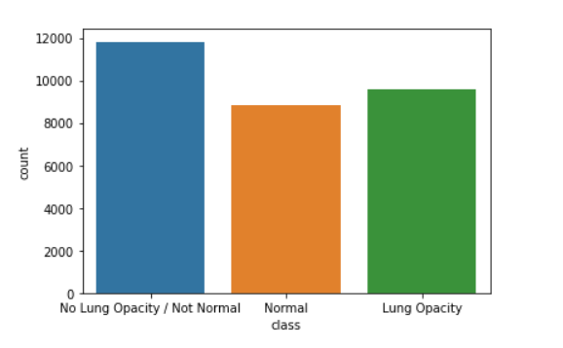
Inferences from the data
There were two features in the data:
Patient ID
Class
There were 26,684 unique patient IDs, while there are around 30,000 entries. There are 3543 duplicated records.
There are three different classes:
Lung Opacity (31.61 % of the patients)
Normal Class (39.1 % of the patients)
Lung Opacity / Not Normal (29.28 %)
The patient IDs were duplicated because of the possibility of two boxes being plotted on the same image.

Slide 11
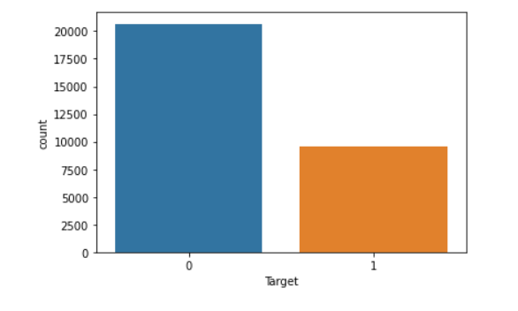
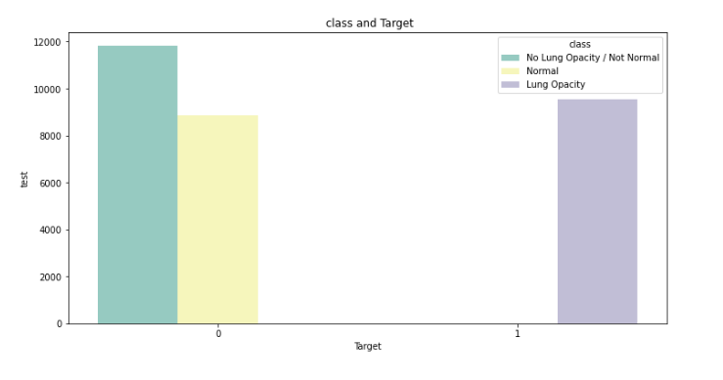
Inferences from the data (Contd..)
There are 2 different classes:
1 → Corresponding to “Lung Opacity”
0 → Corresponding to “Normal Class” and “Lung Opacity / Not Normal” classes.
Some patients did not have box dimensions, it was observed that those were the patients corresponding to the ‘0’ class.
75% of the target data corresponds to ‘0’, on further evaluation it was observed that a majority of the data corresponds to the “Lung Opacity / Not Normal” class.

Slide 12
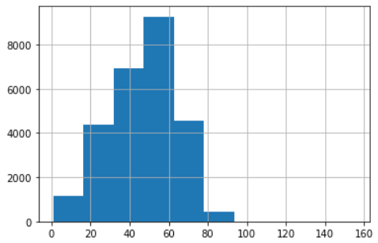
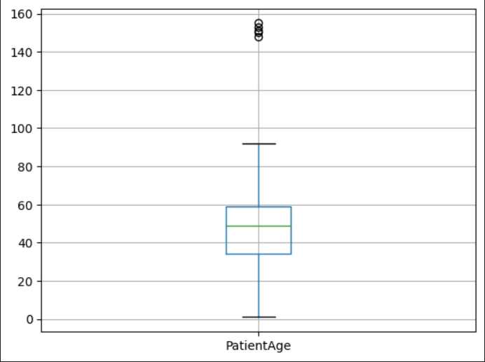
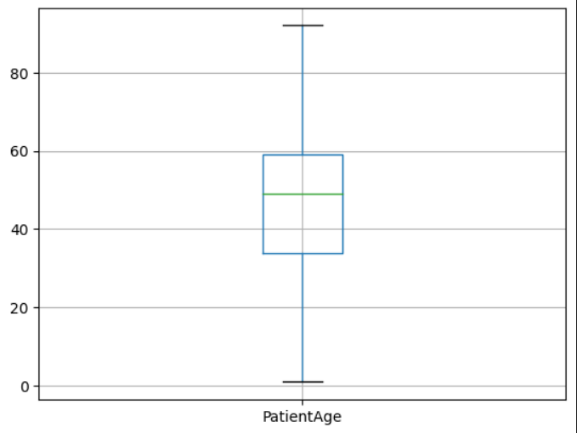
Inferences from the data (Contd..)
It was observed that the distribution of the patient ages were skewed, we were able to remove the outliers and clean the data.

Slide 13
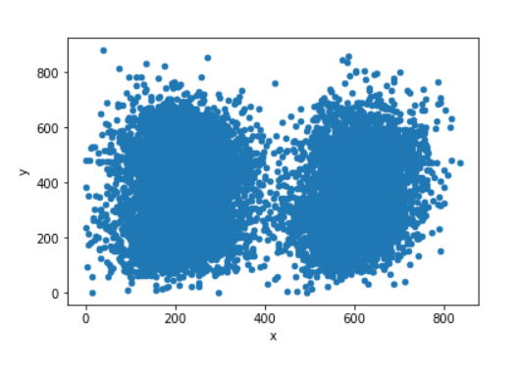
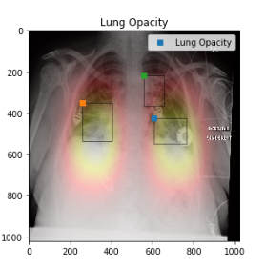
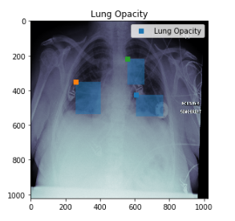
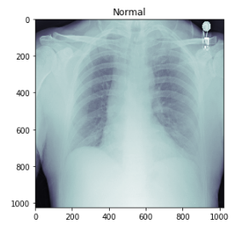
Inferences from the data (Contd..)

Slide 14
Model Building CNN
Model: "sequential"
Layer (type) | Output shape | Param #
conv2d (Conv2D) | (None, 1018, 1018, 32) | 1600
max_pooling2d (MaxPooling2D) | (None, 203, 203, 32) | 0
conv2d_1 (Conv2D) | (None, 199, 199, 64) | 51264
dense (Dense) | (None, 199, 199, 16) | 1040
dense_1 (Dense) | (None, 199, 199, 4) | 68
flatten (Flatten) | (None, 158404) | 0
dense_2 (Dense) | (None, 1) | 158405

Slide 15
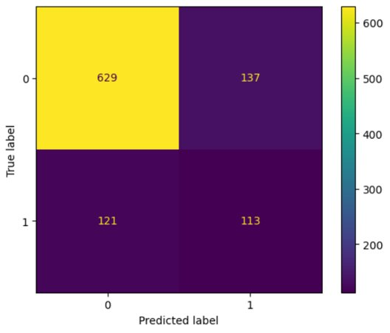
Confusion Metrics

Slide 16
Challenges Faced
CNN model requires a 3 dimensional numpy array, but as the images where grayscale, the arrays were 2 dimensional (1024x1024).
This challenge was overcame by adding another dimension using numpy.

Slide 17
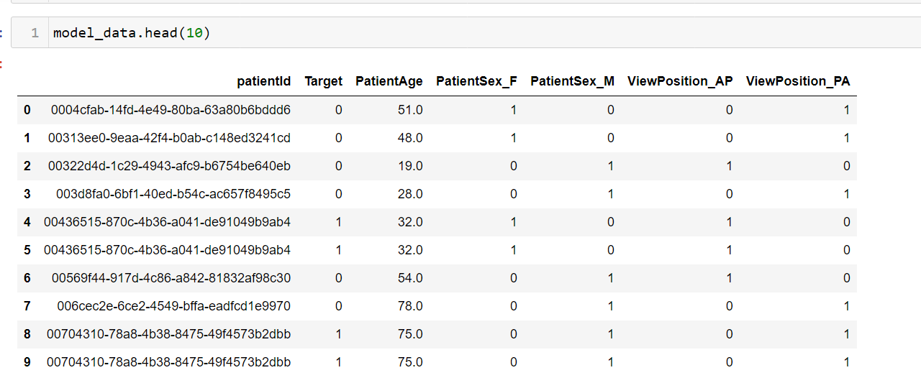
Model Building SVM
These are the labels used for building the model.

Slide 18
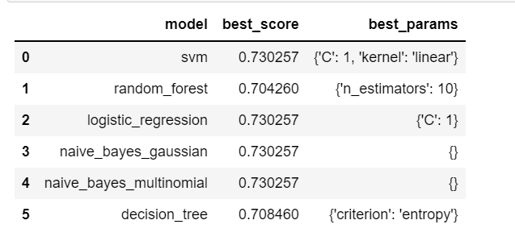
The best score of ml models are derived from GridSearchCV as shown above.

Slide 19
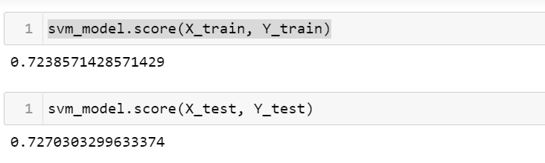
Accuracy:

Slide 20
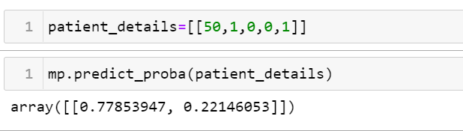
Probability:
Original
Predicted

Slide 21
Conclusion
We were able to understand , visualize and clean the datasets.
We were able to develop two pipelines for pneumonia detection, using the SVM and CNN classifiers.
We were able to design and develop a flask application to deploy our model.

